Slide 1
Introduction to Programming with Python
Vineet Bansal
Research Software Engineer, Center for Statistics & Machine Learning
vineetb@princeton.edu
August 20-24, 2018

Slide 2
Strings
Any real world program deals with readings things from files, and writing things to files and/or the screen. These are passed around as ‘strings’ (though we can convert strings to numbers if we want).
Nothing surprising here:
>>> print(‘Hello World’)
But strings are Unicode-aware:
>>> print(‘नमस्ते’)
Try this in the terminal and the Notebook. Is there a difference?

Slide 3
Defining Strings
>>> greeting = ‘Hello!’
>>> long_string = “We hold these truths to be ‘
‘self evident, that all men are created equal..’
Some operators work on strings
>>> ‘a’ * 4
>>> ‘Hello ‘ + ‘World’
You might do something like this.
>>> str(99) + ‘ bottles of beer’
Format Strings are more flexible (more later).

Slide 4
Escaping Strings
“I’m a very stable genius.”
-- Donald Trump
How do we assign this exact string to a variable quote?

Slide 5
Escaping Strings
>>> quote = “\”I’m a very stable genius.\”\n-- Donald Trump”
>>> quote = ‘”I\’m a very stable genius.”\n-- Donald Trump’
>>> quote = “””“I’m a very stable genius.”\n-- Donald Trump“””

Slide 6
Indexing Strings
Strings are 0-indexed
>>> s = ‘Hello World’
>>> s[0]
‘H’
>>> s[4]
‘o’
Use negative index to count backward, starting at -1
>>> s[-1]
‘d’
Don’t index outside the string length
>>> s[20]
Traceback (most recent call last):
File "<stdin>", line 1, in <module>
IndexError: string index out of range

Slide 7
Slicing Strings
s[i:j] = Substring between index i and j, including i but excluding j
>>> s[0:3]
‘Hel’
>>> s[2:6]
‘llo ‘
Why the asymmetry between how i and j are treated?
Hint: What’s the length of the resulting string?

Slide 8
Slicing Strings
>>> len(s)
11
>>> s[0:len(s)]
‘Hello World’
i or j (or both!) can be left out.
>>> s[:5]
‘Hello’
>>> s[6:]
‘World’
>>> s[:]
‘Hello World’

Slide 9
Slicing Strings
Stride (optional)
>>> s[::2]
‘HloWrd’
Strides can be negative
>>> s[4:0:-1]
‘olle’

Slide 10
Slicing Strings
Why is slicing interesting/useful?
Slicing is a core concept in Python.
Used frequently when you start to slice numpy arrays or pandas Dataframes!
Exercises 2.1, 2.2

Slide 11
Strings are immutable too
>>> s = ‘Alecto Carrow’
>>> s[0:6] = ‘Amycus’
Traceback (most recent call last):
File "<stdin>", line 1, in <module>
TypeError: 'str' object does not support item assignment
But we can create new strings of course:
>>> s = ‘Amycus’ + s[6:]
Notice how the id of s changes!

Slide 12
Common String methods
startswith, endswith, index, strip, lstrip, rstrip, upper, lower, title, split
Notice that a new string is returned in case case. (Methods don’t modify the string ‘in-place’), a new string is returned (which we must save).
This allows for method-chaining:
>>> ' Hello World! '.strip().strip('!').lower().replace('hello’, 'goodbye’).title()
‘Goodbye World’
Exercise 2.3
Used often!

Slide 13
Lists
A collection of ordered stuff (Array)
>>> l = [1, ‘two’, 3.14, 4]
>>> len(l)
4
Indexing/Slicing works the same way as with strings:
>> l[0:2]
[1, ‘two’]

Slide 14
Lists
Test for membership (in keyword) :
>>> 1 in l
True
>>> ‘three’ in l
False
in also works for strings:
>>> s = ‘Hello World’
>>> ‘h’ in s
False
>>> ‘H’ in s
True

Slide 15
Lists
Lists are mutable.
>>> l[2] = 3.0
>>> l
[1, ‘two’, 3.0, 0]
Notice that the id of l does not change.

Slide 16
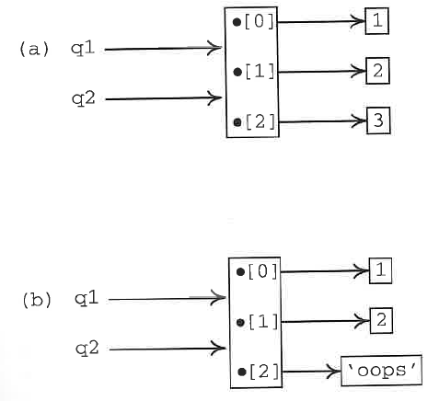
Lists
>>> q1 = [1, 2, 3]
>>> q2 = q1
>>> q1[2] = ‘oops’
>>> q1
[1, 2, ‘oops’
>>> q2
[1, 2, ‘oops’]

Slide 17
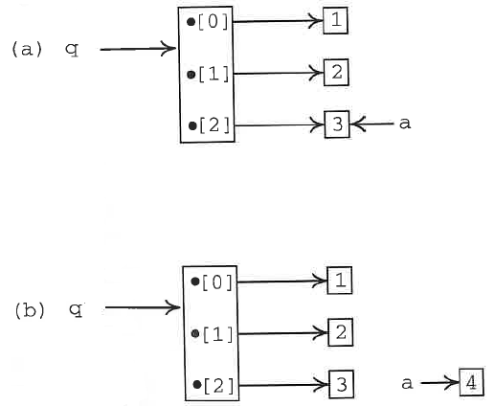
Lists
>>> a = 3
>>> q = [1, 2, a]
>>> a = 4
>>> q
[1, 2, 3]
>>> a
4

Slide 18
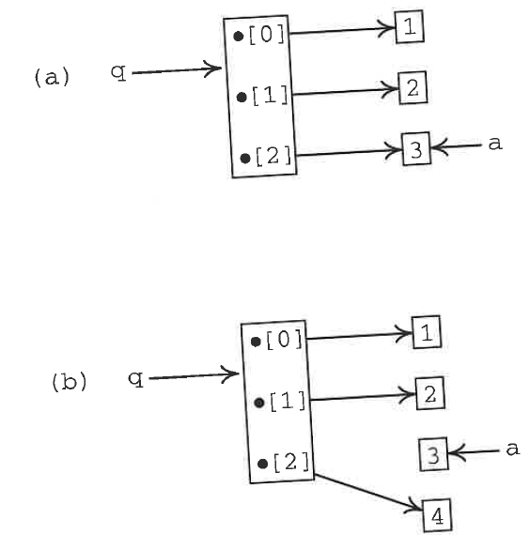
Lists
>>> a = 3
>>> q = [1, 2, a]
>>> q[2] = 4
>>> q
[1, 2, 4]
>>> a
3

Slide 19
Common List Methods
append, extend, index, insert, reverse, sort
Used often!
Work in-place
How do we know which operations work in-place and which operations return a new string/list?
In general, mutable objects can be modified in place, so Python does so. But it doesn’t have to, so just try it and see.

Slide 20
Making a copy of a List
>>> list1 = [1, 2, 3]
>>> list2 = list1
>>> list1 is list2
True
>>> list2 = list1.copy()
>>> list1 is list2
False
>>> list2 = list1[:]
>>> list1 is list2
False
You’ll see this a lot in real programs.

Slide 21
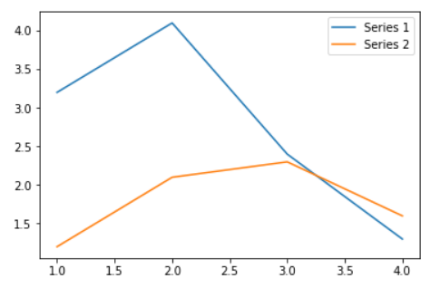
Interlude: Plotting in Notebooks
Now that we know how to create lists of numbers, let’s see how we can plot them in a Jupyter Notebook.

Slide 22
Tuples
Use ‘(‘ and ‘)’ instead of ‘[‘ and ‘]’
>>> t = (1, 2, 3)
Immutable version of List.
Indexing/Slicing works the same
Cannot insert/delete/append once created
Fast! (items stored at consecutive memory locations)

Slide 23
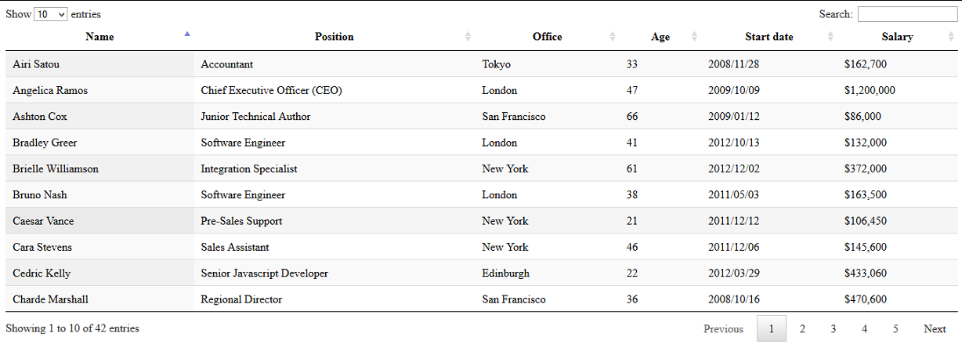
Tuples
Why do we need tuples at all?
Useful when a sequence of items should not be altered.
Each row is a tuple
We have a list of
rows

Slide 24
Tuple Packing/Unpacking
The ‘(‘ and ‘)’ can be omitted during assignment. Python ‘packs’ the individual items into a tuple.
>>> t = 1, 2, 3
>>> type(t)
<class ‘tuple’>
Similarly, tuple unpacking is a common way of assigning multiple variables in one line:
>>> a, b, c = 97, 98, 99
>>> b
98

Slide 25
Tuple Packing/Unpacking
This allows us to write the world’s shortest code to swap two variables:
>>> a = 1
>>> b = 10
>>> a, b = b, a
>>> a
10
>>> b
1

Slide 26
Iterables
Some built-in functions (len, sum, max, min, any, all, sorted) seem to work on strings/lists/tuples:
>>> max(‘Hello’)
‘o’
>>> max([3,4,1,2])
4
>>> max((3,4,1,2))
4
Is there something common across a string/list/tuple?
All of them are collections of stuff – and can give us things ‘one at a time’, i.e. they are iterable

Slide 27
for loops
Objects that are iterable can be looped over, giving us one item at a time, using a for loop:
for x in <iterable>:
<do_something>
<do_something>
In each iteration of the loop, a new item from <iterable> is put into x
Colon
Body of the loop (x keeps changing value)
Move code over (indent) to specify what you want done inside the loop

Slide 28
for loops
We’ll talk in terms of a list to keep things clear.
>>> names = [‘Homer’, ‘Marge’, ‘Lisa’, ‘Bart’, ‘Maggie’]
>>> for name in names:
... print(name)
...
Homer
Marge
Lisa
Bart
Maggie
Mnemonic Naming!

Slide 29
for loops
Use a loop to sum up a list of numbers.
l = [6, 4, 1, 2, 3, 0]
total = 0
for n in l:
total += n
print(total)

Slide 30
A note on indentation
An indented block of code tells Python when the loop ends.
total_salary = 0
for salary in salaries:
print(‘Salary = ‘, salary)
total_salary = total_salary + salary
print(‘Total Salary = ‘, total_salary)
Python doesn’t care if you use spaces or tabs, but by convention, use 4 spaces for an indent (most Python editors will convert tabs to spaces).
Don’t mix tabs/spaces within a block (illegal), or within your program (sloppy).

Slide 31
The range type
We often need to refer to a sequence of consecutive numbers. For example:
Sum up the series (1+2+3+..+99)
range(N) = 0, 1, 2, .. N-1
>>> range(10)
range(0, 10)
>>> list(range(10))
[0,1,2,3,4,5,6,7,8,9]

Slide 32
for loops
Exercises 2.4, 2.5

Slide 33
Control Flow – if/else
Few computer programs are executed in a purely linear fashion. Blocks of code are usually executed conditionally on the basis of some test carried out on data.
if <logical expression 1>:
<statements 1>
elif <logical expression 2>:
<statements 2>
...
else:
<statements>

Slide 34
Control Flow – if/else
Few computer programs are executed in a purely linear fashion. Blocks of code are usually executed conditionally on the basis of some test carried out on data.
for x in range(10):
if x <= 3:
print(x, ‘is less than or equal to 3’)
elif x > 5:
print(x, ‘is greater than 5’)
else:
print(x, ‘must be four of five, then’)

Slide 35
Control Flow – if/else
Exercises 2.6, 2.7

Slide 36
while loops
Whereas a for loop is established for a fixed number of iterations, statements within the block of a while loop execute only and as long as some condition holds.
>>> i = 0
>>> while i < 10:
... i += 1
... print(i, end=‘.’)
>>> print()
1.2.3.4.5.6.7.8.9.10

Slide 37
break/continue
Use break to immediately end the loop.
Find the first negative number in a list of numbers:
alist = [0, 4, 5, -2, 5, 10]
for a in alist:
if a<0:
break
print(a)

Slide 38
break/continue
The continue statement acts in a similar way to break but instead of breaking out of the containing loop, it immediately forces the next iteration of the loop.
Print only even integers in a given range.
N = 100
for i in range(1, N+1):
if i%2:
continue
print(i, ‘is even’)

Slide 39
while loops
Exercise
Do this exercise in the terminal rather than the jupyter notebook (jupyter notebook is not particularly good at getting user input!)
Write a Python program that asks the user to respond by ‘y’ or 'yes’ (case doesn’t matter). The program keeps on asking until the user enters the correct information. (Use the ‘input’ function to get a response from the user).

Slide 40
File input/output
Mode | Meaning
'r' | open for reading (default)
'w' | open for writing, truncating the file first
'x' | open for exclusive creation, failing if the file already exists
'a' | open for writing, appending to the end of the file if it exists
'b' | binary mode
't' | text mode (default)
'+' | open a disk file for updating (reading and writing)
A File object is created by opening a file with a given filename and mode.
f = open(‘myfile.txt’, ‘w’)
f.write(‘Hello World’)
f.close()
Python closes any File objects automatically when a program terminates.

Slide 41
Reading from a file
readline() reads a single line from a file, up to and including the newline character. The next call to readline() reads the next line. It returns an empty string when it reaches the end of the file.
To read all the lines into a list pf strings, use f.readlines()
File objects are iterable too, and looping over a (text) file returns its lines one at a time.

Slide 42
Reading from a file
Exercises 2.8, 2.9, 2.10

